Slide 1

LUNG CANCER IMAGING TOOL
MEDICAL IMAGING
2021
A tool For Medical Image Processing and Cancer Segmentation on Lung-CT images
Marco Peracchi 800578
Federico De Servi 812166

Slide 2

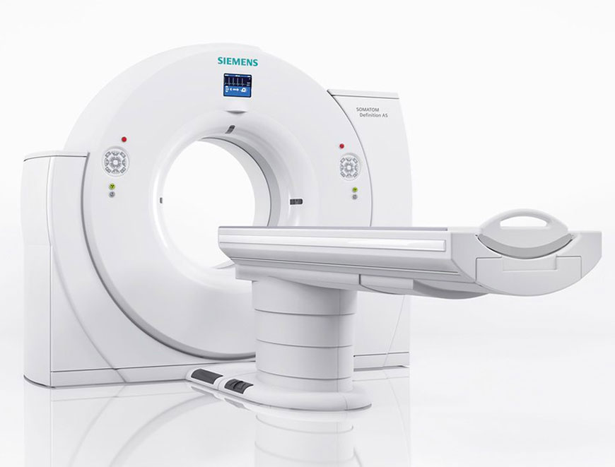
Topics
Introduction
Image Visualization Tool
Image Segmentation Tool
Clustering and Classification Tool

Slide 3
INTRODUCTION

Slide 4


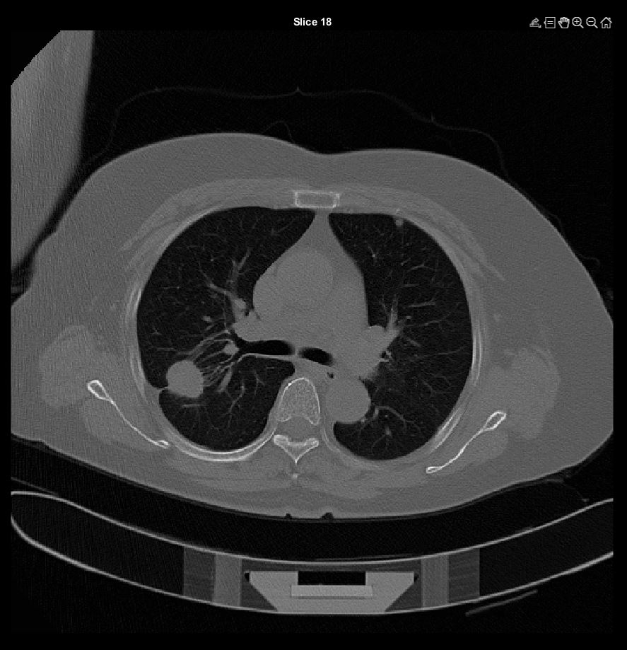
Lung cancer
Lung cancer is a lung tumor characterized by an uncontrolled cellular grown inside the primary organ of respiratory system. Lung cancer is by far the leading cause of cancer death among both men and women, making about 25% of all death due to cancer.

Slide 5



Dataset
Downloaded from Cancer Archive
Almost 8 Gb
Data of 23 patients
CT images
We kept only 12 patients with 5 mm CT resolution

Slide 6


Patient CTs visualization
10 images overview
All images overview
Specific CT visualization
Segmentation Tool
Manual Segmentation
Ouputs volume and other relavant features
Clustering and classification tool
The tool: overview
The lung cancer imaging tool is oriented toward a visualization approach: CT images are showed to better visualize the abnormal tumoral mass, and all desired slices can be seen. Moreover, tool asks user if the doctor wants to perform manual segmentation image by image.
Finally, through the previous performed operation, different biomarkers are computed, including the volume.
The clustering and classification tool clusters the data in n clusters and performs unsupervised classification.

Slide 7
Image visualization tool

Slide 8


CT Visualizations
Different visualizations are showed:
A composition of 9 images, showing a few slices
All the slices
A single slice selected by user

Slide 9
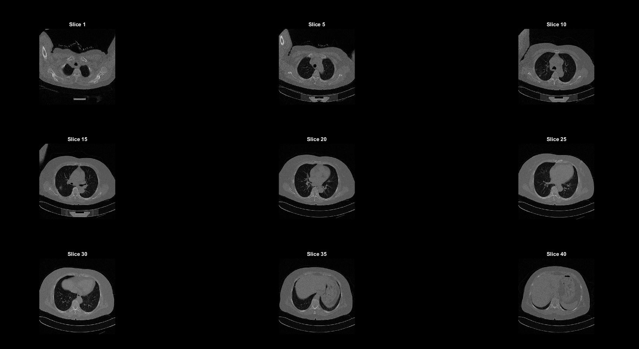
Results

Slide 10
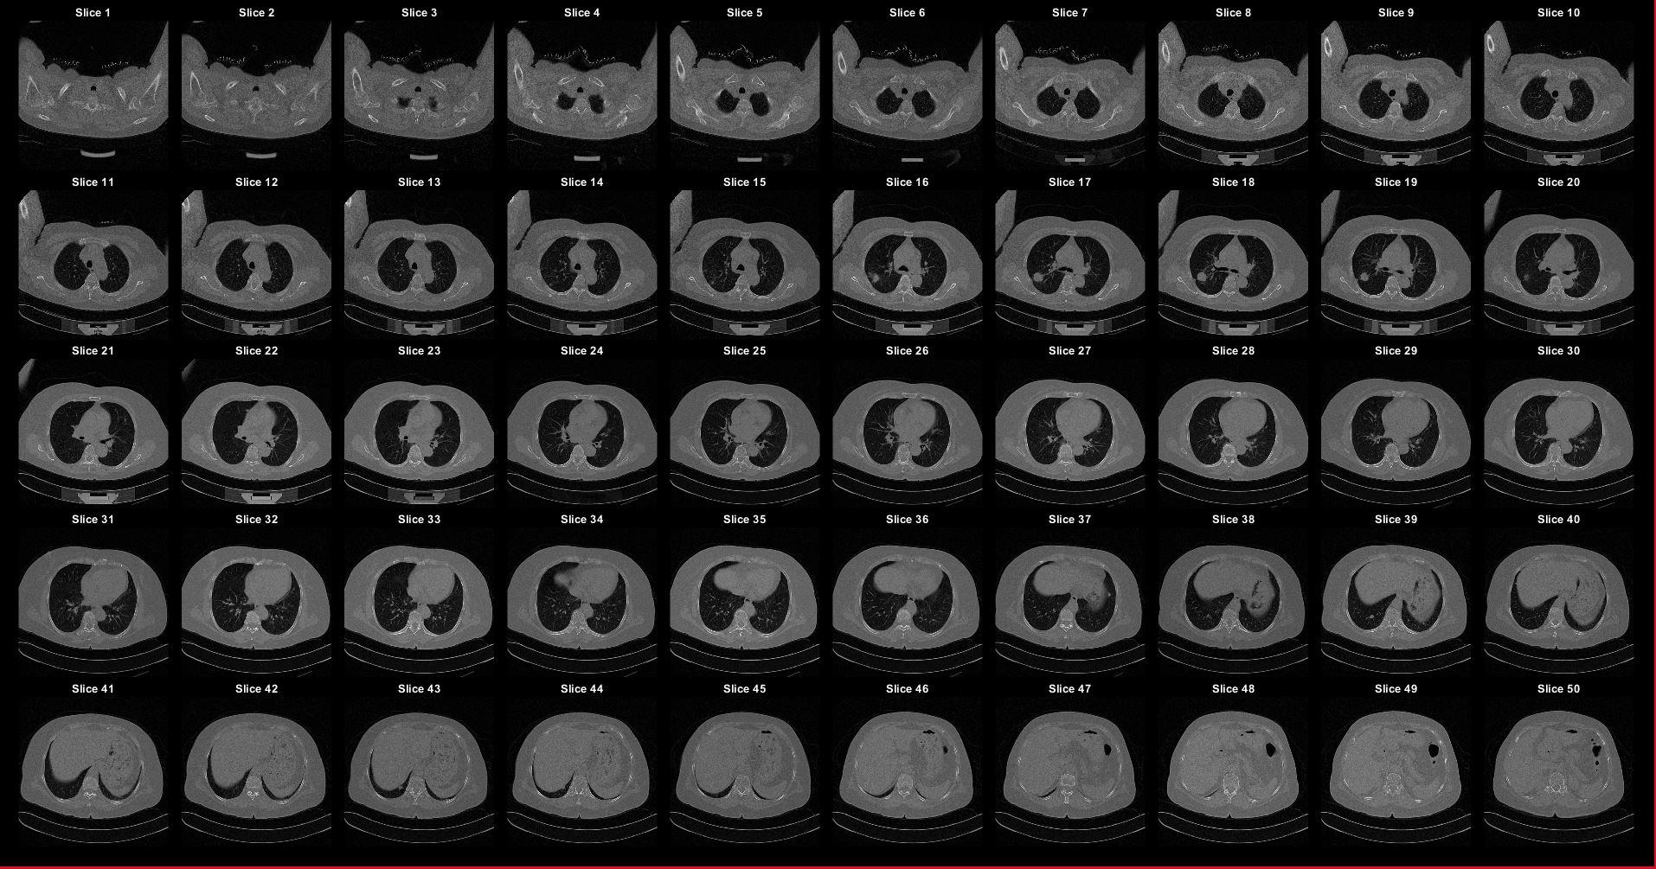
Results

Slide 11


Results

Slide 12
Image SEGMENTATION tool

Slide 13

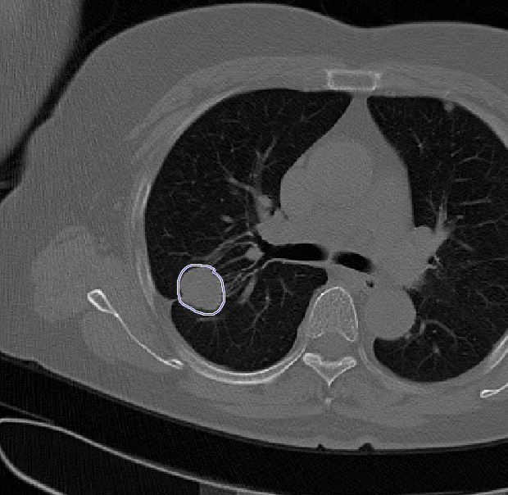
Cancer segmentation
Segmentation works through the selection of the region of interest (ROI) manually by the user.
The mask is then saved and used to compute features that are valuable for the forthcoming machine learning algorithms, like volume, sphericity etc.

Slide 14
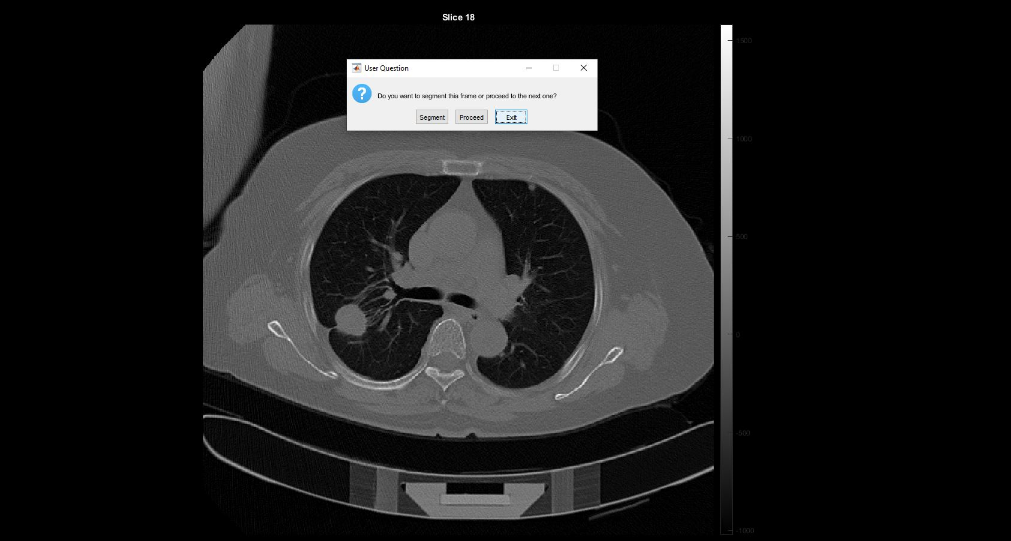
Results

Slide 15


Feature extraction
As previously said, different features are extracted from each segmented slice:
Then, the features of each segmented slice are combined to obtain the full features relative to the segmented lesion.
Volume
Area
R
Spherical disproportion
Sphericities
Surface/Volume Ratio

Slide 16
Results example
sliceNum | volumes mm3 | areas | Rs | spherical_disproportions | sphericities | surfacevolume__ratios
16 | 451,578331 | 8,218227386 | 4,759355675 | 0,028871674 | 34,63602415 | 0,018198897
17 | 1140,829468 | 26,55687256 | 6,48202508 | 0,050297413 | 19,8817381 | 0,023278565
18 | 1250,158958 | 24,6500499 | 6,682806341 | 0,043922817 | 22,76721 | 0,019717533
19 | 722,5253296 | 20,47115601 | 5,566576167 | 0,052572205 | 19,02145822 | 0,028332787
20 | 2,376728058 | 0,147397537 | 0,827872827 | 0,017114062 | 58,43148082 | 0,062016997

Slide 17
VISUALIZATION AND SEGMENTATION TOOL DEMO

Slide 18
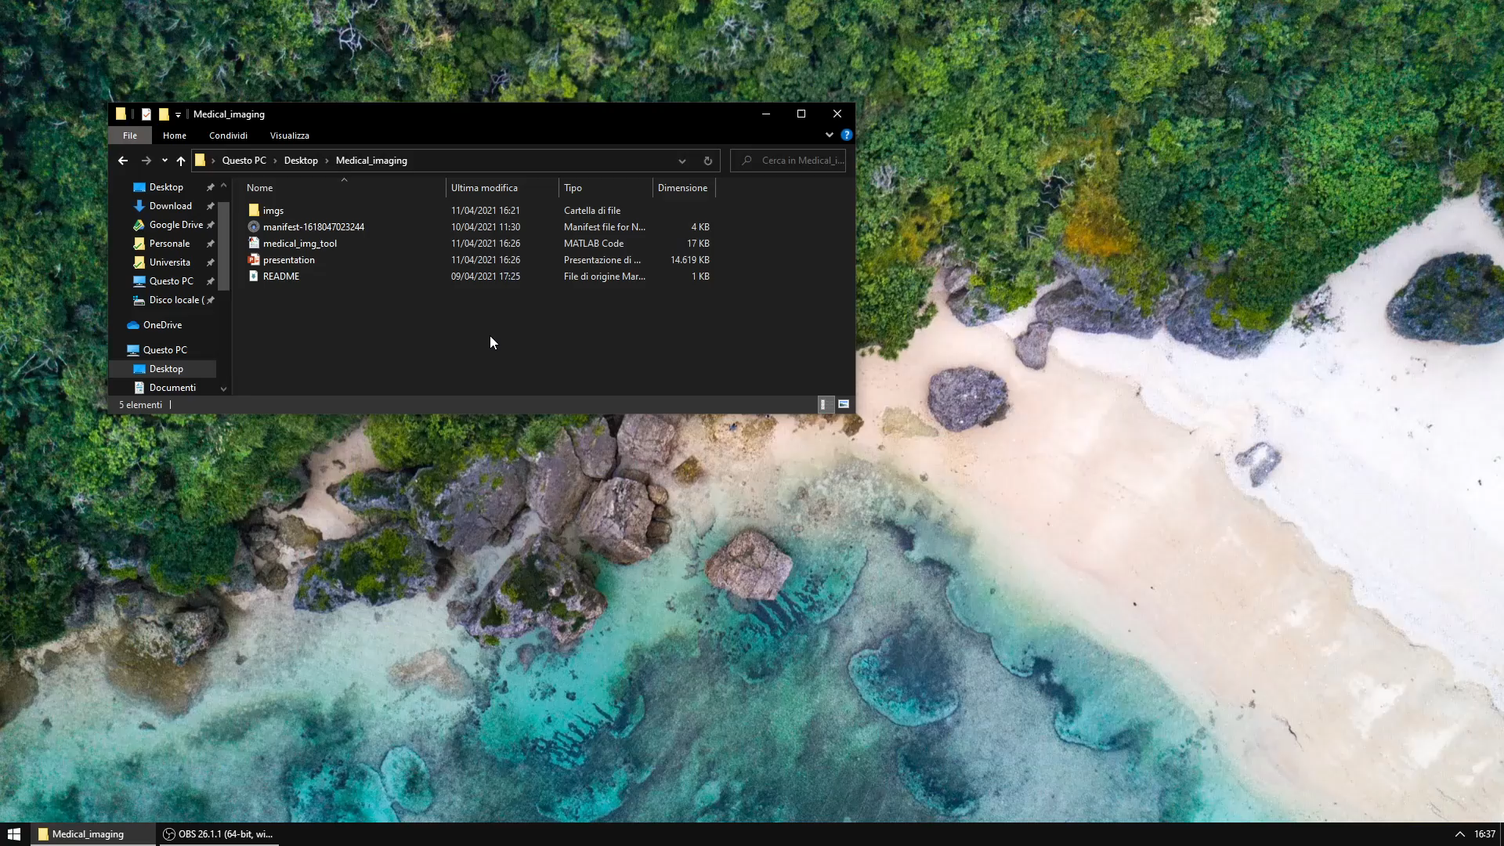
Demo

Slide 19
CLUSTERING AND CLASSIFICATION

Slide 20


Clustering and classification
Exploiting the features extracted, we managed to build a clustering algorithm that grouped lesions according to their characteristics.
For this purpose, a k-means algorithm has been implemented, and a target of 3 clusters has been set (a different number can be selected by the doctor).

Slide 21
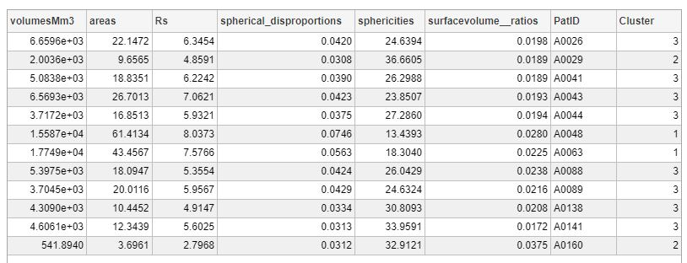
Results
Cluster 1
Clustering
High area, low sphericity
Cluster 2
High area, low sphericity
Cluster 3
High area, low sphericity

Slide 22
Clustering and classification
After that, a KNN Classifier and a Classifier tree have been applied, with the cluster id as label.
These algorithms are trained only on the most discriminative features, which are selected using LDA.
The classifiers performed well, with 50% acc for the KNN and 50% for the Classifier Tree.
NB! Small dataset used, this means that accuracy values are not reliable

Slide 23
clustering AND classification TOOL DEMO

Slide 24
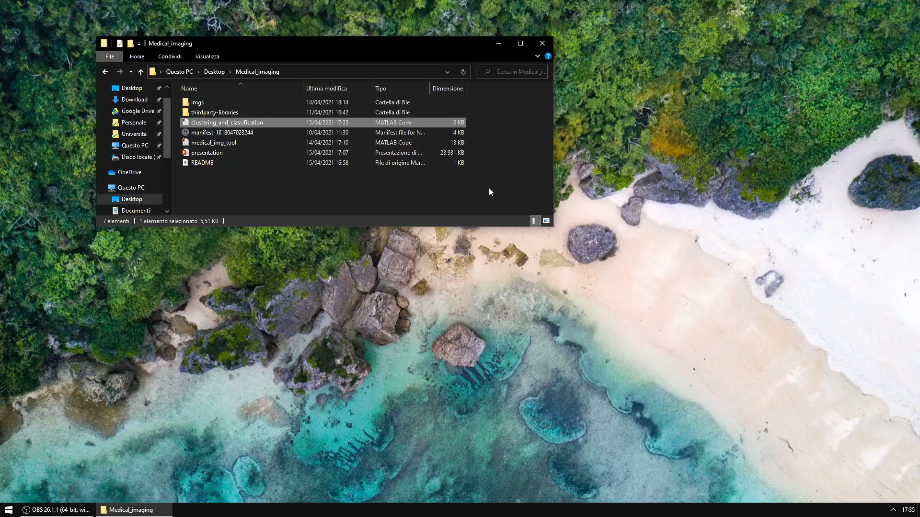
Demo

Slide 25

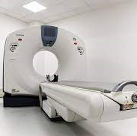

THANK YOU
Marco Peracchi- 800578
Federico De Servi - 812166

